Slide 1


SPRING BOOT APPLICATION WITH REDIS
Aadil Anthrollil Abu
245268
BATCH 3

Slide 2

what is Redis?
Redis is a NoSQL database which follows the principle of key-value store. The key-value store provides ability to store some data called a value, inside a key. You can recieve this data later only if you know the exact key used to store it.
Redis is a flexible, open-source (BSD licensed), in-memory data structure store, used as database, cache, and message broker. Redis is a NoSQL database so it facilitates users to store huge amount of data without the limit of a Relational database.
Redis supports various types of data structures like strings, hashes, lists, sets, sorted sets, bitmaps, hyperloglogs and geospatial indexes with radius queries.

Slide 3
Redis Architecture
There are two main processes in Redis architecture:
(1) Redis Client
(2) Redis Server
These client and server can be on same computer or two different computers.

Slide 4
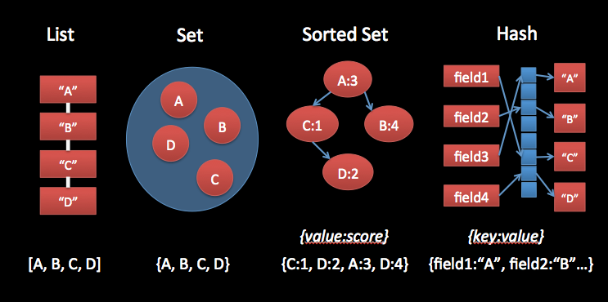
Data Structure types
Redis allows us to store keys that map to any one of five different data structure types:
STRING, LIST, SET, HASH, and ZSETs.

Slide 5
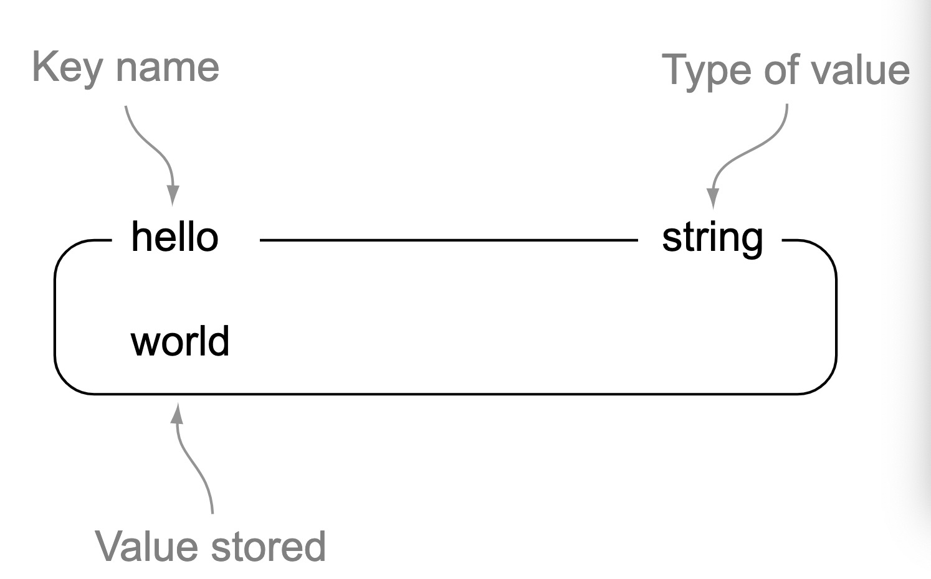
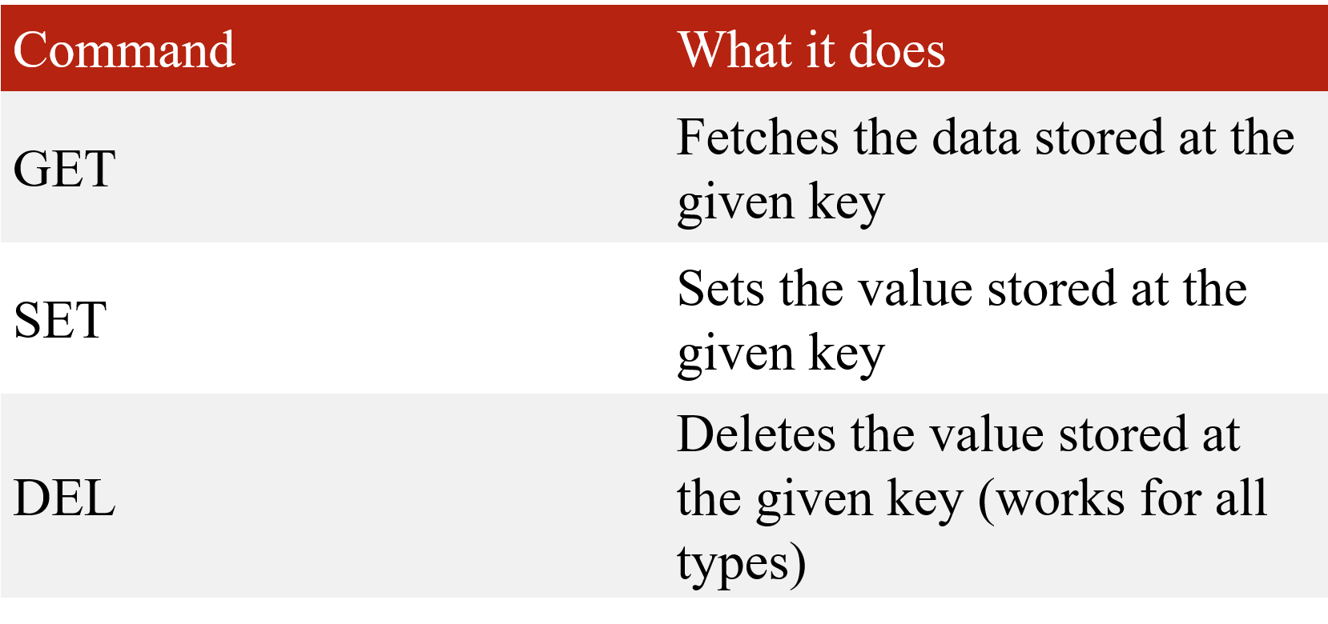
Strings in Redis
In Redis, STRINGs are similar to strings that we see in other languages
Command used on STRING values
An example of a STRING, world, stored under a key, hello

Slide 6
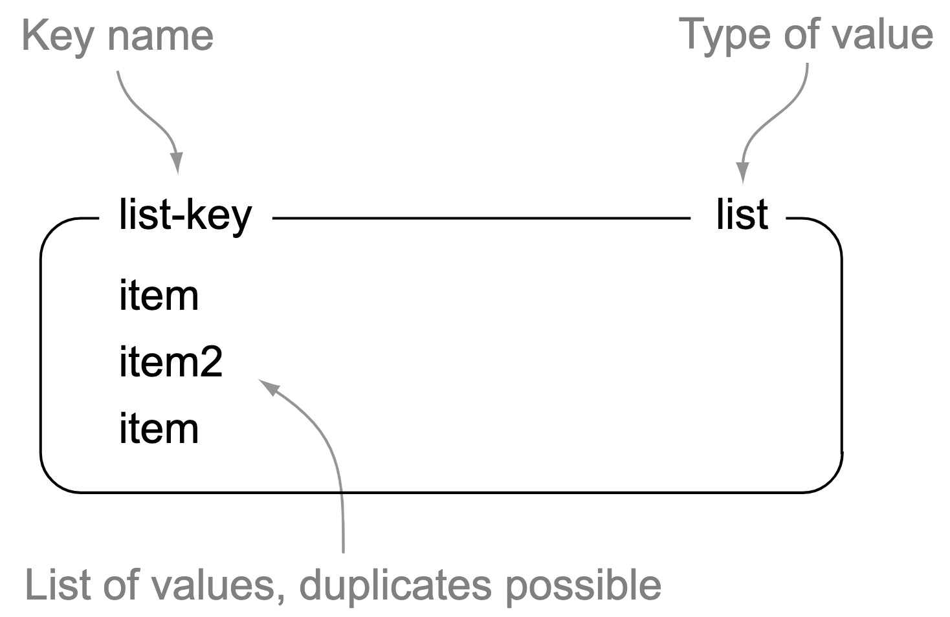
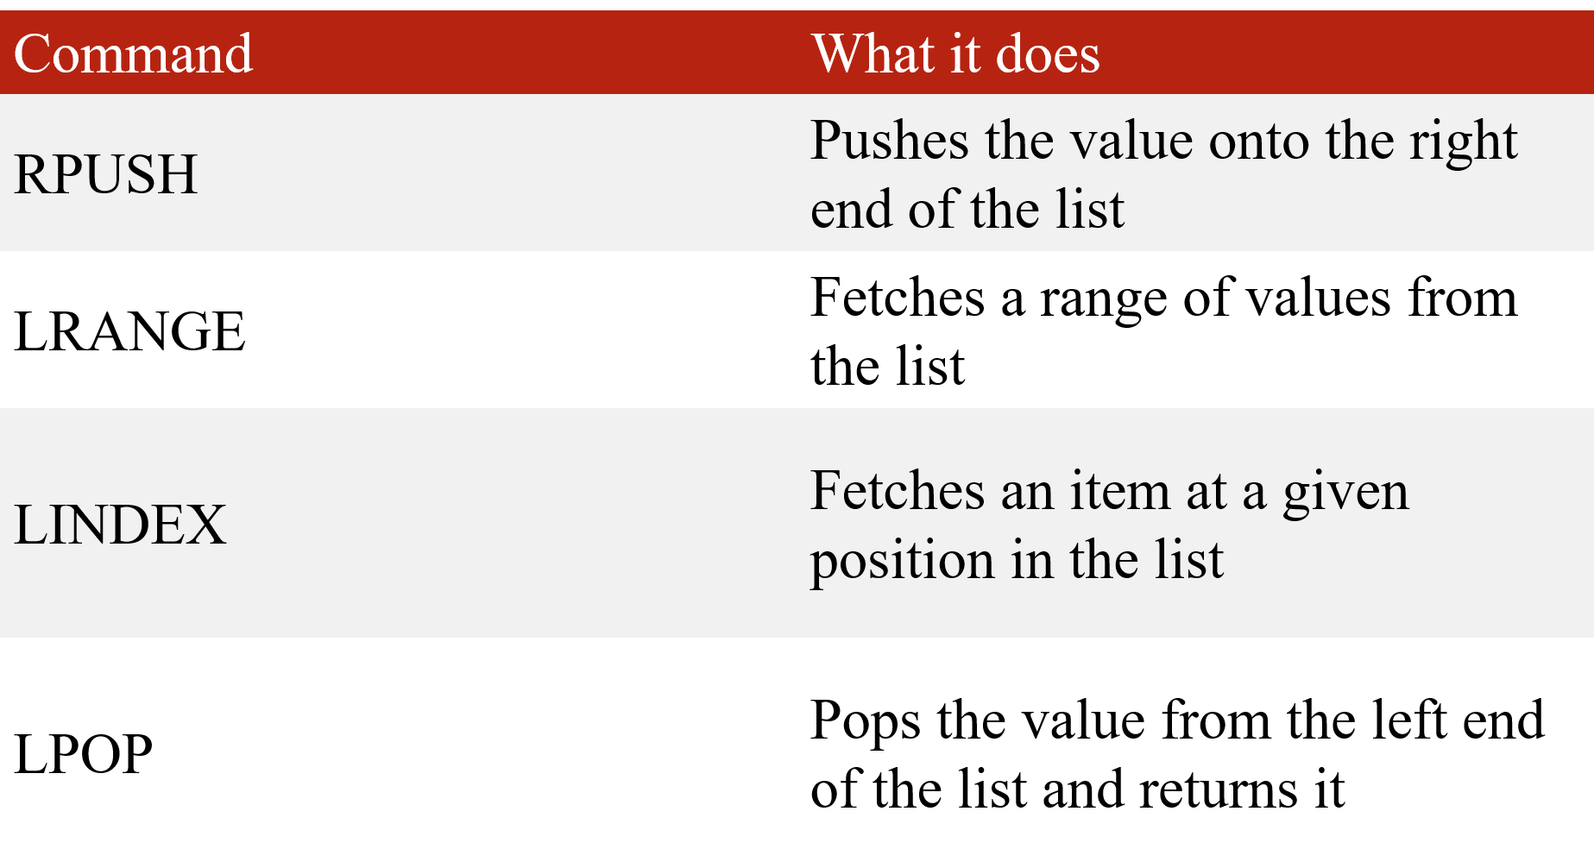
Lists in Redis
In key-value stores, Redis is unique in that it supports a linked-list structure.
Command used on LIST values
An example of a LIST with three items under the key, list-key

Slide 7
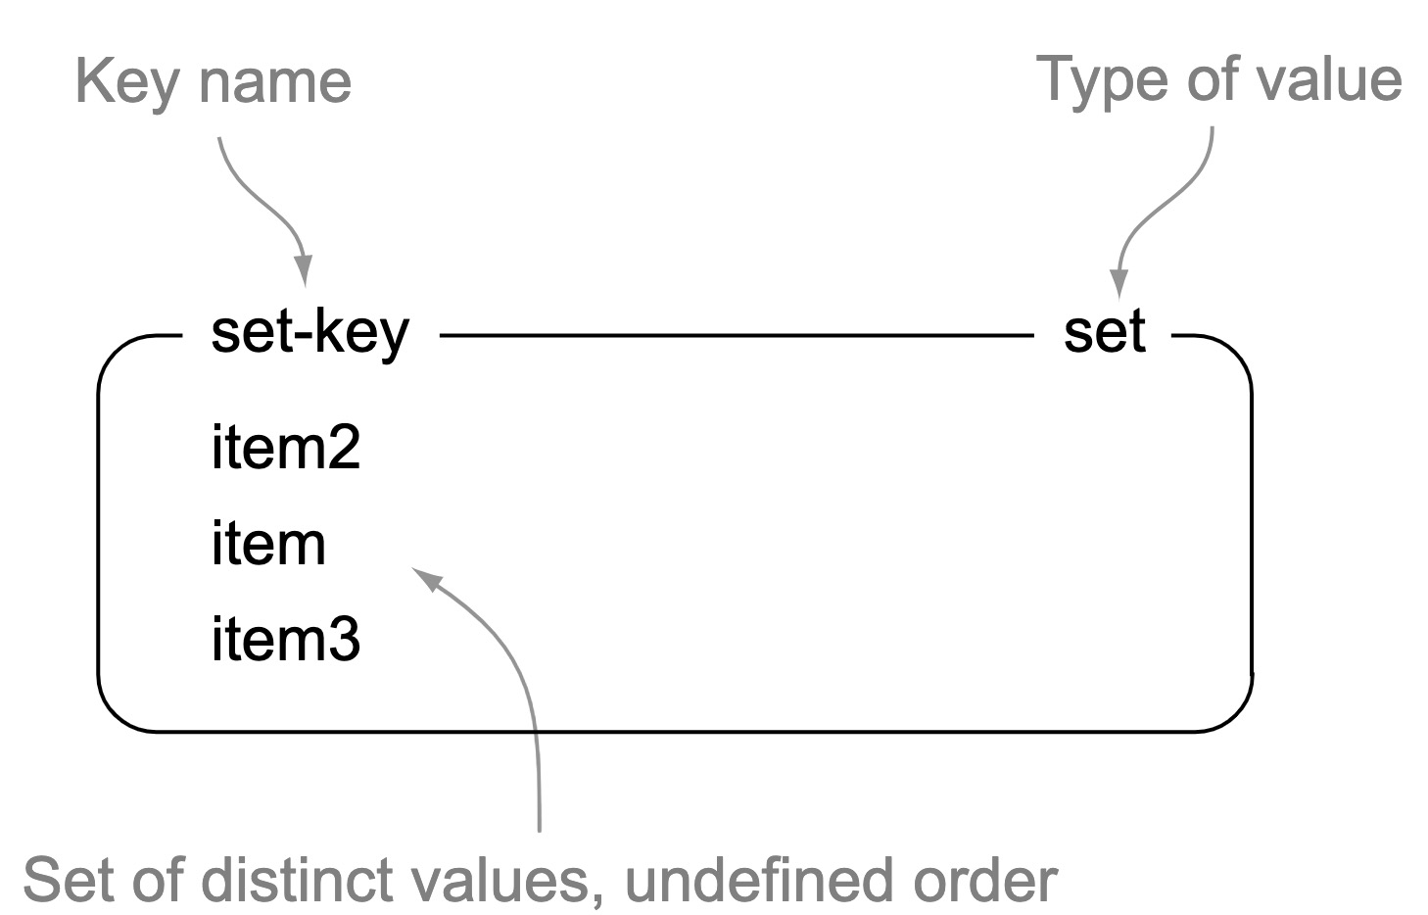
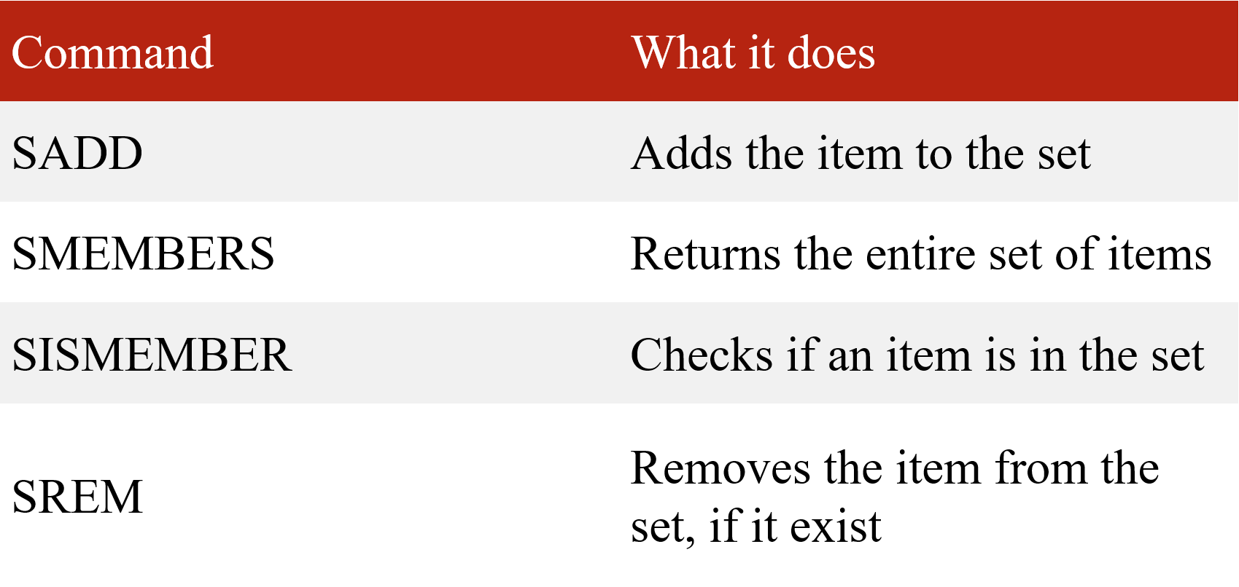
Sets in Redis
In Redis, SETs are similar to LISTs in that they’re a sequence of strings, but unlike LISTs, Redis SETs use a hash table to keep all strings unique
Command used on SET values
An example of a SET with three items under the key, set-key

Slide 8
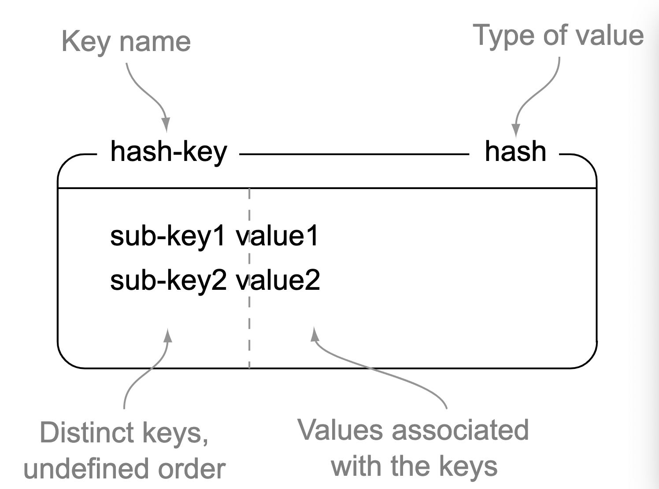
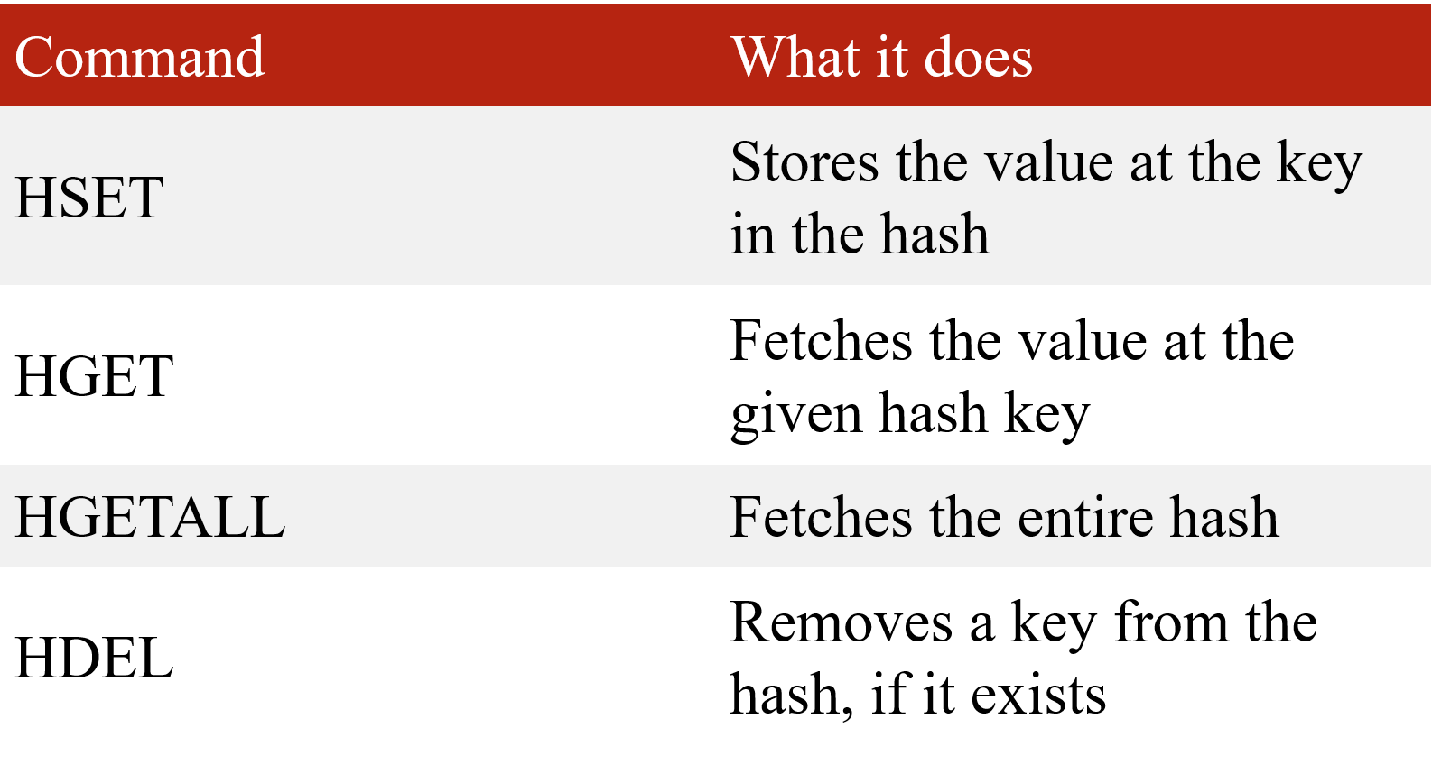
Hashes in Redis
Redis HASHes store a mapping of keys to values.
Command used on HASH values
An example of a HASH with two keys/values under the key, hash-key

Slide 9
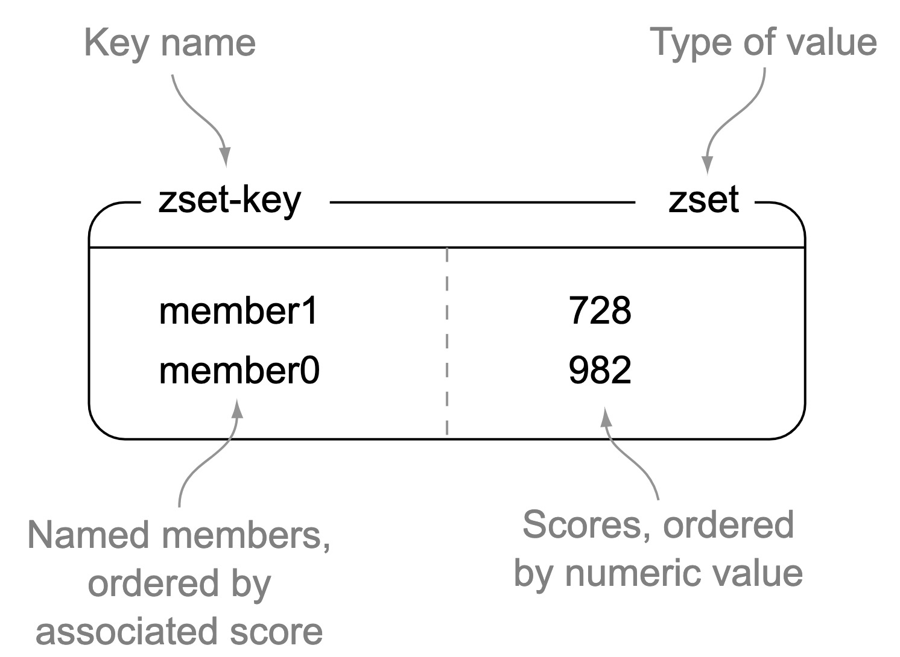
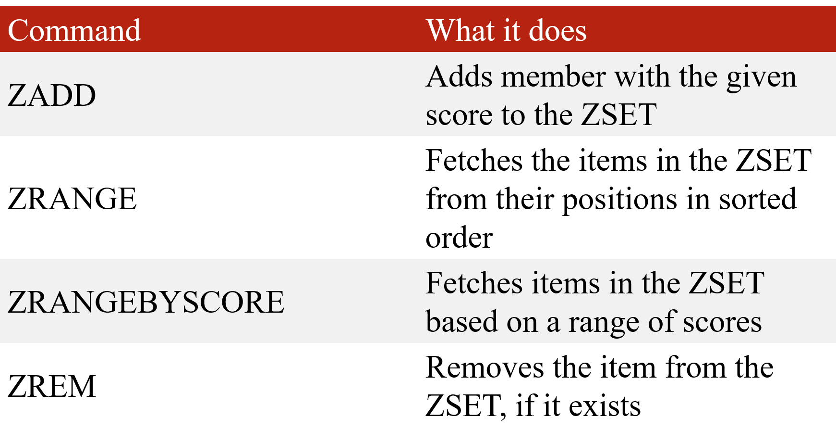
Zsets in Redis
Like Redis HASHes, ZSETs also hold a type of key and value. The keys (called members) are unique, and the values (called scores) are limited to floating-point numbers.
Command used on HASH values
An example of a ZSET with two members/scores under the key, zset-key

Slide 10
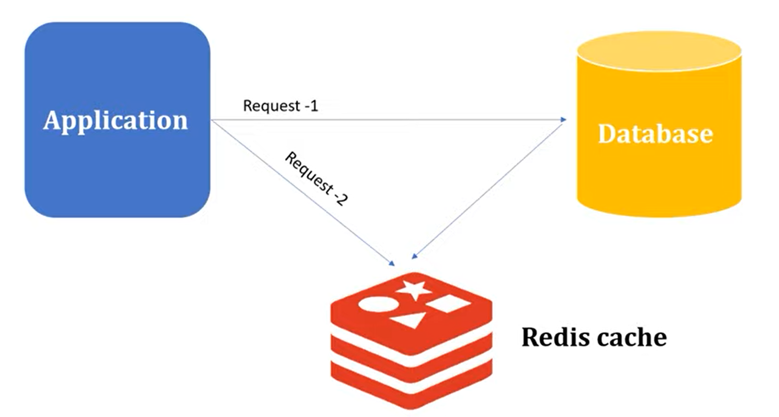
Caching in Redis

Slide 11
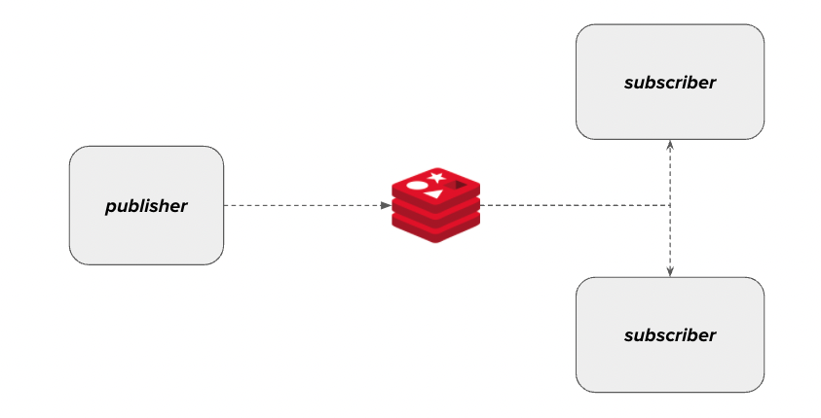
Redis as Message Broker

Slide 12
References
Github link- https://github.com/aadil-zeyn/RedisDBandMQ
Redis- https://redis.io/

Slide 13
THANK YOU

